Slide 1


MANGALORE INSTITUTE OF TECHNOLOGY & ENGINEERING
(An ISO 9001:2015 Certified, Accredited by NAAC with A+ Grade)
Badaga Mijar, Moodabidri
DEPARTMENT OF ELECTRONICS & COMMUNICATION ENGINEERING
(Accredited by NBA)
Phase -3 Presentation
on
VISUAL CRYPTOGRAPHY FOR BIOMETRIC PRIVACY
Project Associates:
SUPRABHA 4MT18EC089
SOORAJ SHETTY 4MT18EC088
SHRAVAN KUMAR 4MT18EC079
M B SACHIN 4MT18EC045
Under the Guidance:
Mr. Ganesh V N
Senior Assistant Professor
Department of Electronics & Communication Engineering

Slide 2
INTRODUCTION
In today’s fast developing era, security plays a very important role in the daily life.
Today, more and more digital documents are transmitted and exchanged on internet. Security has become the important features in communication and other text information, this is because of the presence of hackers who wait for a chance to gain an access to private data.
A biometric authentication system operates by acquiring raw biometric data from a subject, extracting a feature set from the data and comparing the feature set against the templates stored in a database in order to identify a person or to verify a claimed identity.
Many biometric techniques are available such as fingerprint, face, iris, retina, palm print, hand vein, facial thermogram, keystroke, voice, hand geometry and signature etc.
The template data in the database is generated during enrolment and is often stored along with the original raw data.

Slide 3
PROBLEM STATEMENT
When we transmit data over the network, then any unauthenticated person can read our data. So, in order to provide the security to data generally the sender will encrypt the data and then send it to the intended person and the receiver will decrypt that encrypted data and uses it.
Visual Cryptography comes with the guarantee of the security by means of defining perfect secrecy. Mainly, retrieval of original information without losing the secret contents against the action of hackers in the network is a very challenging problem in today’s world.

Slide 4
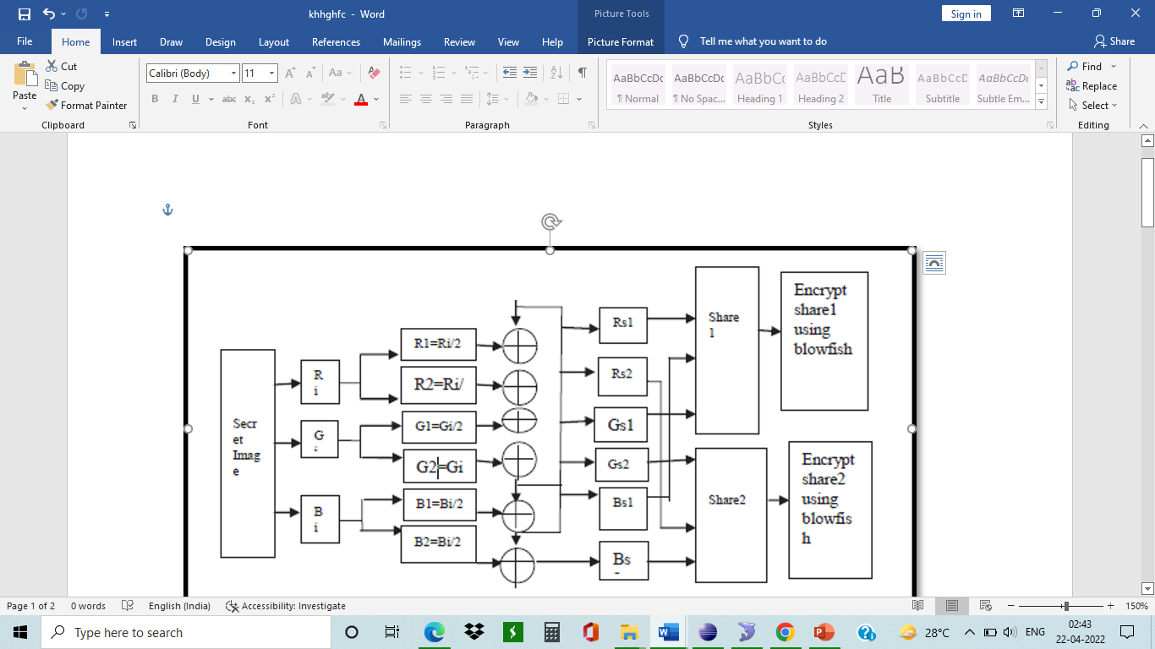
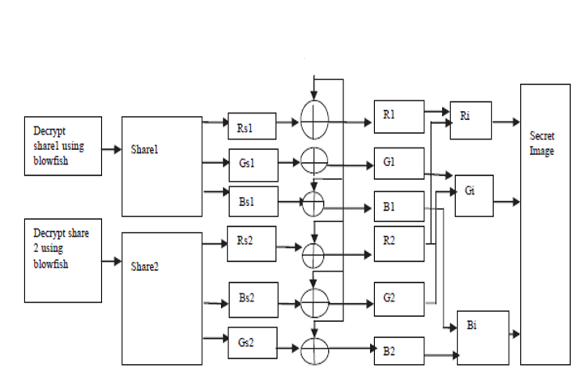
METHODOLOGY
Decryption Method
Encryption Method

Slide 5
Software Requirements:
1) Operating System - Windows
2) Front End – HTML, JAVA
3) Back End – Servlet, JSP
4) Scripts - JavaScript
5) Database – MySQL
Hardware Requirements:
Personal computers with required Configuration.
Software's:
Apache Tomcat Server
Eclipse IDE
MySQL

Slide 6
WORK PROGRESS
Literature survey is completed, inputs are taken from the journals.
Finalized the programming language.
Installed the required software’s.
Completed Login Page
Encryption process completed.
Decryption process completed.
Completed the Journal paper.
Completed the face matching.

Slide 7
REFERENCES
[1] Arun Ross, Asem Othman, “Visual Cryptography for Biometric Privacy”, IEEE Transactions On Information Forensics And Security, VOL.6 No.1, MARCH 2011.
[2] Naor, M. and Shamir, A. (1995) “Visual Cryptography” EUROCRYPT 1994. Lecture Notes in Computer Science, Vol. 950. Springer, Berlin, Heidelberg.
[3] Shefali Arora & M.P.S Bhatia, “Challenges and opportunities in biometric security: A survey”, Information Security Journal: A Global Perspective (2021), DOI: 10.1080/19393555.2021.1873464.
[4] Jeng-Shyang Pan, Tao Liu, Hong-Mei Yang, Bin Yan, Shu-Chuan Chu, Tongtong Zhu, “Visual cryptography scheme for secret colour images with colour QR codes”, Elsevier November 2021.
[5] Jyoti Tripathi, Anu Saini, Kishan, Nikhil, Shazad, “Enhanced Visual Cryptography: An Augmented Model for Image Security”, (ICCIDS 2019), Published by Elsevier B.V.
[6] M. Karolin and T. Meyyappan, “Secret Multiple Share Creation with Color Images using Visual Cryptography”, International Conference on Communication and Signal Processing, April 4-6, 2019, India, IEEE
[7] P. Punithavathi & S. Geetha (2017), “Visual cryptography: A brief survey”, Information Security Journal: A Global Perspective, 26:6, 305-317, DOI: 10.1080/19393555.2017.1386249 (Taylor & Francis).
[8] Apurva A. Mohod, Prof. Komal B. Bijwe, An Image Database Security Using Multilayer Multi Share Visual Cryptography: A Review, ISSN 2319 -4847, Volume 3, Issue 10, October 2014.

Slide 8
[9] Atul Sureshpant Akotkar, Chaitali Choudhary, “Secure of Face Authentication using Visual Cryptography”, International Journal of Innovative Science and Modern Engineering (IJISME) ISSN: 2319-6386, Volume-2, Issue-5, April 2014.
[10] Shubhangi Rajanwar1, Shirish Kumbar2, Akshay Jadhav, “Visual Cryptography for Biometric Privacy”, International Journal of Science and Research (IJSR), ISSN: 2319-7064, Volume 3 Issue 12, December 2014.
[11] N. Askari, H.M. Heys, and C.R. Moloney, “An Extended Visual Cryptography Scheme Without Pixel Expansion For Halftone Images”.
[12] Bhagyashri P. Kandalkar, Gopal D. Dalavi, “Development of Visual Cryptography Technique for Authentication using Facial Images”, International Journal of Science and Research (IJSR), ISSN: 2319-7064, Volume 4 Issue 12, December 2016.
[13] Dr. D. Devakumari MCA., M.Phil., PhD.1, K. Geetha, “A Survey of Visual Cryptographic Method for Secure Data Transmission”, ISO 3297:2007 Certified Vol. 6, Issue 6, June 2017.
[14] Tiwari, Meher Gayatri Devi; Kakelli, Anil Kumar. “Secure Online Voting System using Visual Cryptography”, Walailak Journal of Science &Tachnology Vol 18, Issue 15, January 2021.
[15] Mr. Ravi Kumar, Ms. Namrata Singh, “A survey based on Enhanced the Security of Image using the combined techniques of steganography and cryptography”, International Conference on Innovative Computing and Communication (ICICC 2020).
[16] Santhi, B K.S. Ravichandran , A.P. Arun and L. Chakkrapani,” A Novel Cryptographic Key Generation Method Using Image Features”, Research Journal of Information Techology 4(2):88-92, 2012.

